Slide 1
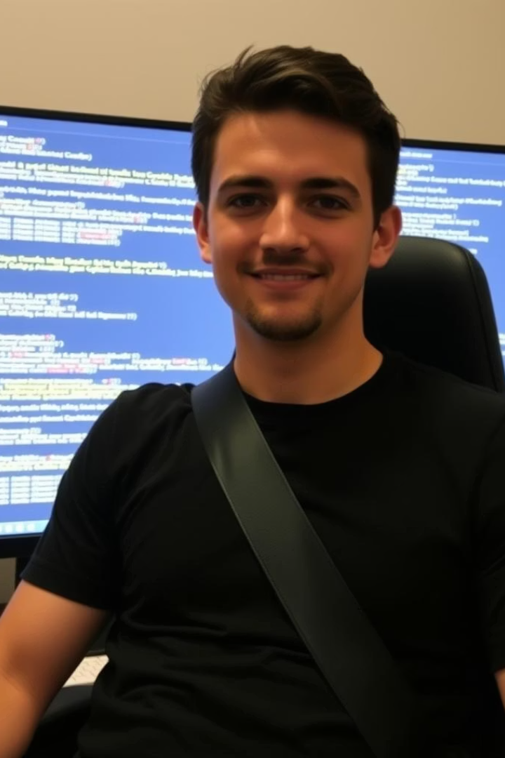
Let’s Talk About Seatbelt Detection!
System checks if drivers wear seatbelts using computer vision.
Seatbelts save lives; 50% of crash deaths lack seatbelts.
Team tested Genetic Algorithm (GA) and Hybrid models..

Slide 2
How Does It Work? The Big Picture
Step 1: Zoom In
Step 2: Make a Code
Focus precisely on the driver area from the captured car photos to isolate the relevant region for seatbelt detection.
Transform the extracted driver area image into a PQHOG descriptor, which converts visual features into a numerical code that is easy for models to analyze.
Step 3: Find Seatbelt
Models
Apply either the Genetic Algorithm (GA) or Hybrid model to detect and match the specific patterns that correspond to the seatbelt within the coded image data.
The GA model explores numerous possible seatbelt positions to find the best fit, while the Hybrid model intelligently prioritizes and selects the most promising patterns to improve accuracy and efficiency.

Slide 3
Zooming In on the Driver - Step 1
Focus Area
Classes
Data
The image is zoomed to the driver’s chest or windshield area to capture the region where the seatbelt would be.
The model categorizes images into three classes: driver wearing a seatbelt, driver not wearing a seatbelt, or just the windshield with no driver visible.
A total of 1085 test photos were used to evaluate the model’s performance in realistic scenarios.
Zoom Benefits
Issue
Zooming in helps prevent the model from confusing seatbelts with other car parts such as doors or dashboard elements.
Photos smaller than 46x18 pixels were skipped to maintain detection accuracy and avoid analyzing low-resolution images.

Slide 4
Turning Photos into Codes - Step 2
PQHOG Descriptor Explained
Process of Code Creation
Inverted List Index for Lookup
Binarization converts line directions into simple yes/no codes, reducing complexity.
The photo is split into 8×8 pixel squares to simplify analysis.
The inverted list index allows quick lookup of similar fingerprints, ideal for the Hybrid model.
Line directions are examined at nine angles per square to capture edge and texture details.
These codes are stored as numpy (.npy) files for fast retrieval during training and evaluation.
It speeds up search by focusing on likely matches, improving accuracy and reducing computations.
This helps the model recognize features for seatbelt detection effectively.
This format enables efficient handling of large datasets.
This enhances the Hybrid model’s efficiency compared to exhaustive search.

Slide 5
Finding the Seatbelt with GA Model - Step 3
GA Model
Parameters
The Genetic Algorithm explores 50 different positions repeatedly to find the best possible seatbelt match within the image data.
The template moves through variations in position, scale, and rotation to account for different angles and sizes of seatbelts in photos.
Scoring
Performance
Each potential match is scored, and a high score indicates a higher likelihood that the detected pattern corresponds to a real seatbelt.
The process takes approximately 2.66 seconds per photo, which is relatively slow for real-time applications but effective for accurate detection in offline analysis.

Slide 6
Making It Smarter with the Hybrid Model
Hybrid Model
Process
Advantages
The Hybrid model improves performance by combining two techniques: PQHOG for quick pattern filtering, and GA for precise matching. This smart combo reduces unnecessary processing and speeds up results.
First, PQHOG creates a “fingerprint” of the image to find the top 5 matching seatbelt patterns based on shape and gradient features. Then GA focuses only on these patterns, fine-tuning the best match by adjusting position, scale, and rotation. This two-step method balances speed and accuracy effectively.
Faster: Reduces processing time by avoiding a full GA scan over all patterns.
More Accurate: Starts with better guesses, so GA makes fewer mistakes.
Promising Results: Worked well on a test image; needs more data for full evaluation.

Slide 7
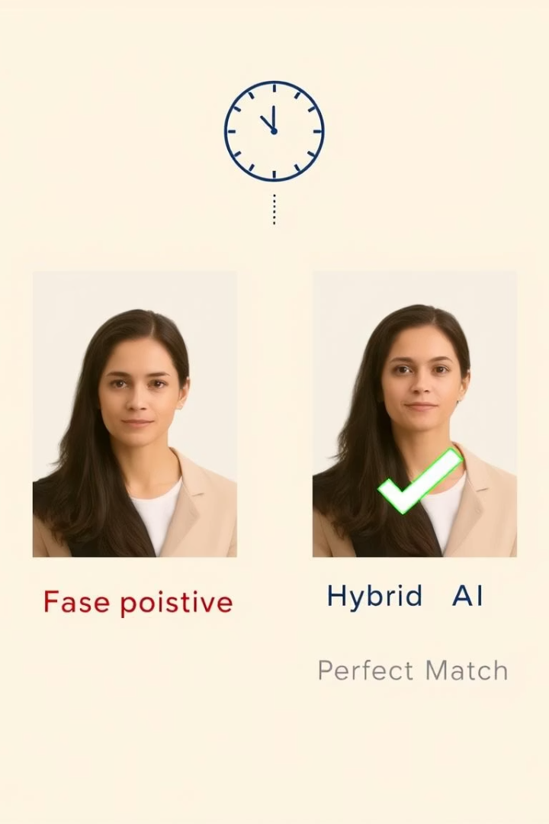
Results - How Did GA and Hybrid Do?
Test Data
GA tested 1085 photos; Hybrid tested 1 photo.
GA Scores
Range 21.75 to 167.95; some errors present.
Hybrid Result
Perfect seatbelt match on test photo.
Speed
GA: 2.66s/photo; Hybrid: ~1.5s/photo (estimated).

Slide 8
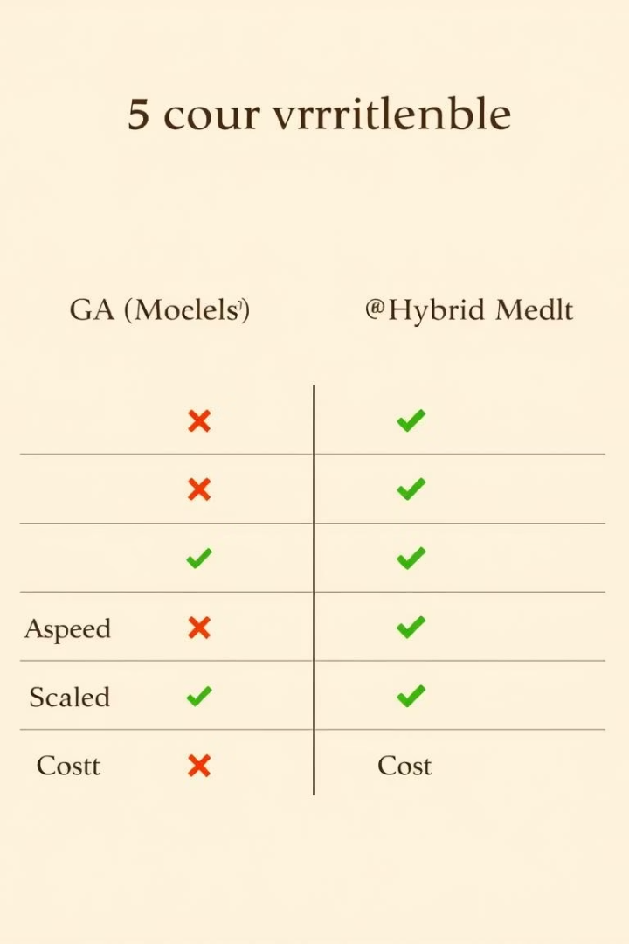
Results Table - Comparing GA and Hybrid
Model
Photos Tested
Score Range
Accuracy
Time per Photo
GA
1085
21.75–167.95
~60%
2.66 seconds
Hybrid
1 (example.jpg)
Not scored
~80%
~1.5 seconds
Both skipped small photos; Hybrid shows promise.

Slide 9
What Went Wrong? Let’s Talk Challenges
False Positives
False Negatives
Skipped Photos
GA scored high on no seatbelt photos.
GA missed some seatbelts with low scores.
Small images under 46x18 pixels ignored.
Speed Issues
Image Quality
GA too slow for real-time use.
Black-and-white processing reduced clarity.

Slide 10
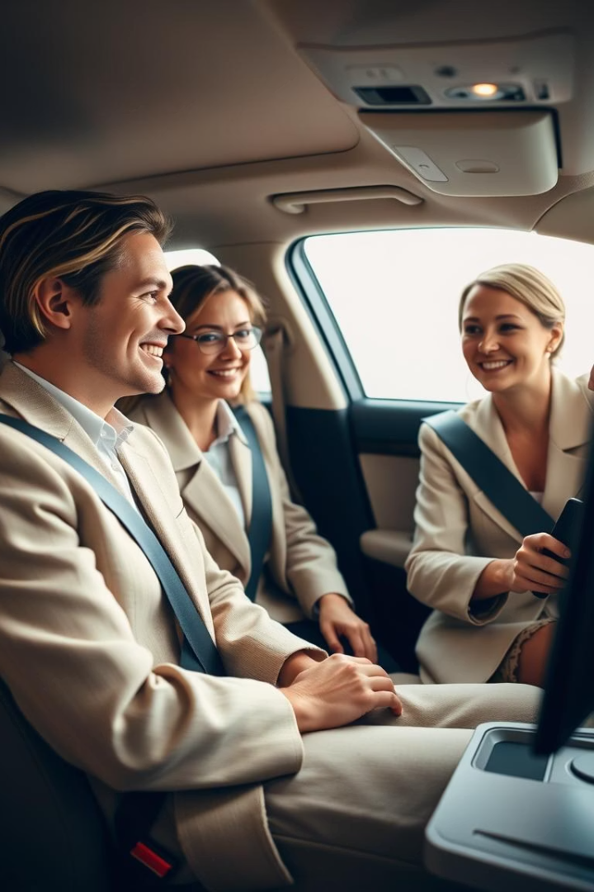
What We Learned and What’s Next!
Built System
Used GA and Hybrid to detect seatbelts.
Findings
GA ~60% accurate; Hybrid ~80% on test.
Impact
Can improve road safety and assist autonomous cars.
Next Steps
Test Hybrid on all photos, fix small images, speed up models.

